Slide 1

Customer predictive analysis
On Brazilian E-Commerce Dataset
By Nicholas Satyahadi

Slide 2
Presentation Overview
Data exploration
Model development
Prediction Analysis & decision making

Slide 3
Introduction
The Brazilian E-commerce Dataset will serve as an example on how one would create a machine learning model to conduct predictive analysis.
Focus of the model: Predict whether if the customer will return after they made their purchase(s) and received it.

Slide 4
Data Exploration
Data Cleaning:
The product category name will be translated into English due to language barrier.
Products with NULL descriptions (e.g. name, length, weight) had been removed in order to prevent errors.
Data Standardization:
The order items dataset had been summarized to show how many items purchased per order instead of using order_item_id.

Slide 5
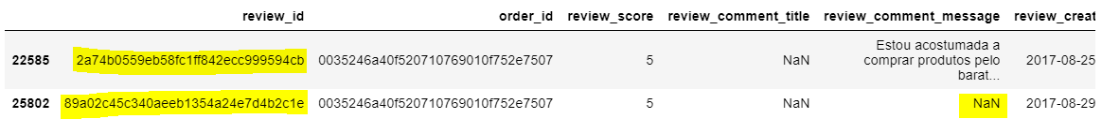
Data Exploration Order Reviews
Not all order have reviews, and one order might have multiple reviews for multiple products. An order id is used as a perfect example of the conditions as shown below. Nevertheless, the review is still valid since not all customers will leave comments.

Slide 6
Data Exploration Order Status
These are order statuses that the system will generate in order:
Created
Invoiced
Approved
Processing
Shipped
Delivered
Since we want to understand the customers’ purchasing behavior, it’s essential for us to only observe valid delivered orders, meaning the orders have complete and correct (no NULLs) records of delivery.

Slide 7
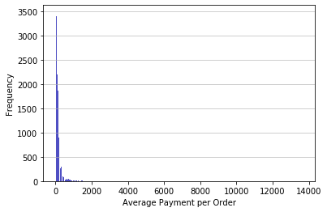
Data Exploration Payment Amounts
Majority of the payment values below 2000 with the 3rd quantile around below 200 (exact number: 171.13).
Less than 5% of orders have payment amount above 500.

Slide 8
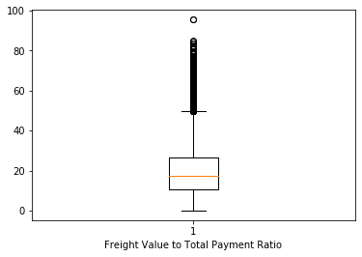
Data Exploration Freight Value to Payment Ratio
Most of the orders have freight value to total payment ratio below 50%.
It’s appropriate for customers prefer to make a purchase when the freight value doesn’t cover majority of the payment.
Even so, it doesn’t eliminate the possibility that there are some customers willing to pay such high freight value.

Slide 9
Model Development
The return of the customer relates on how “loyal” the customer is to the store. Hence, here are some variables that would affect the customer’s loyalty:
Factors | Explanation
Order review | High reviews indicate trust from customer to the store
Average payment per order | High payment along with high review increases trust towards the store and indicates a high satisfactory purchase
Freight value to total payment ratio | Freight value relates to the distance between the seller and the customer, also the weight of the item. If the freight value covers most of the payment, it is less likely for the customer to return to make another purchase.

Slide 10
Model Development
The dataset used in the model will be labeled into will return (1) or won’t return (0) according to the variables or factors explained previously.
Logistic Regression and Random Forest classification model will be used and compared to predict.

Slide 11
Model Development Labeling process
The dataset will be labeled into will return (1) and won’t return (0) according to the records in each distinct customer id and order id. Then, the dataset will be divided into train and test dataset.
There will be a condition switching for some records, picked randomly. This switching is conducted in order to create an unlikely condition, e.g. 5 Stars review but labeled as won’t return.
The labeling rules or value thresholds decided according to the findings explained in data exploration sections*.
*attached in the appendix of this slide.

Slide 12
Prediction Result Returning Customers
The prediction predicted 82.09% (19,488 customers) of customers from the test dataset will return for future purchase(s).
The average freight ratio is 19.01%
The table on the right summarizes the top 3 categories based on the number of items purchased.
Category | Number of Items Purchased | Average Payment per Order | Number of Vouchers Used
Bed, Bath, & Table | 2,145 | 222,898 | 59
Health & Beauty | 1,989 | 306,302 | 46
Sports & Leisure | 1,739 | 222,390 | 31

Slide 13
Prediction Result Non-returning Customers
The prediction predicted 17.91% (4,251 customers) of customers from the test dataset will not return for future purchase(s).
The average freight ratio is 23.03%
Despite being predicted to not return, 11.88% (505 orders) of the orders have 5 star review.
The table on the right summarizes the top 3 categories based on the number of items purchased with 5 star reviews.
Category | Number of Items Purchased | Average Payment per Order | Number of Vouchers Used
Electronics | 62 | 2,202 | 0
Telephony | 51 | 2,459 | 2
Health & Beauty | 41 | 3,927 | 0

Slide 14
Decision Making
Promotions:
Cashbacks with minimum payment would increase the basket size (number of items purchased) along with maintaining the total payment per order.
Discounts would reduce with the average payment per order but could effectively attract non-returning customers to return. The discounts could be in embedded in the product itself or using a certain payment method, preferably credit cards since most of the payments are through credit cards.
Freight value discounts with minimum payment would also attract non-returning customers to make a purchase since the average freight ratio from the non-returning customers are higher than the returning customers.
Additional inputs:
Health & beauty products seems to be the main driver since it’s included in both returning and non-returning customers top 3 categories. Maintaining the average payment per order would be recommended.
Raising public awareness about the abundant amount of vouchers that are able to be utilized is recommended to attract non-returning customers and new customers.

Slide 15
Appendix

Slide 16
Labeling Rules
Review Score | Payment | Freight Ratio | Labeled as
< 3 | - | - | 0
= 3 | < 200 | > 50% | 0
= 3 | < 200 | < 50% | 1
= 3 | >= 200 | - | 0
> 3 | - | > 50% | 0
> 3 | - | < 50% | 1

